Slide 1
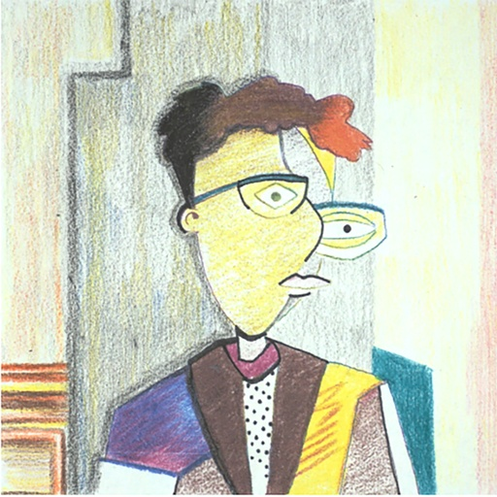
Creative Cubism Cartoons

Slide 2
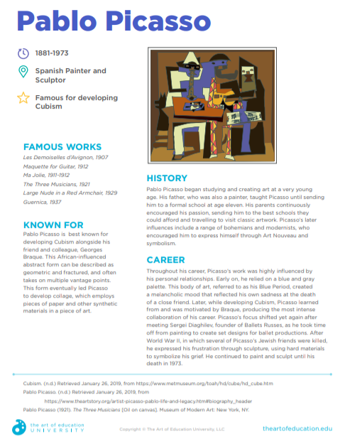
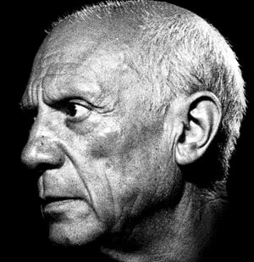
https://www.pablopicasso.org/​

Slide 3
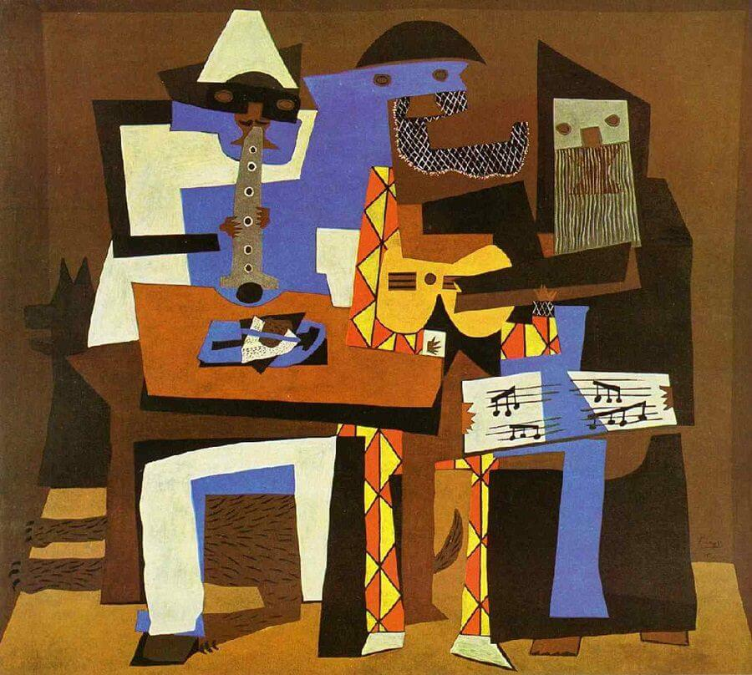
Three Musicians. Pablo Picasso. 1921. Canvas, 200.7 x 22.9 cm. New York, The Museum of Modern Art.

Slide 4
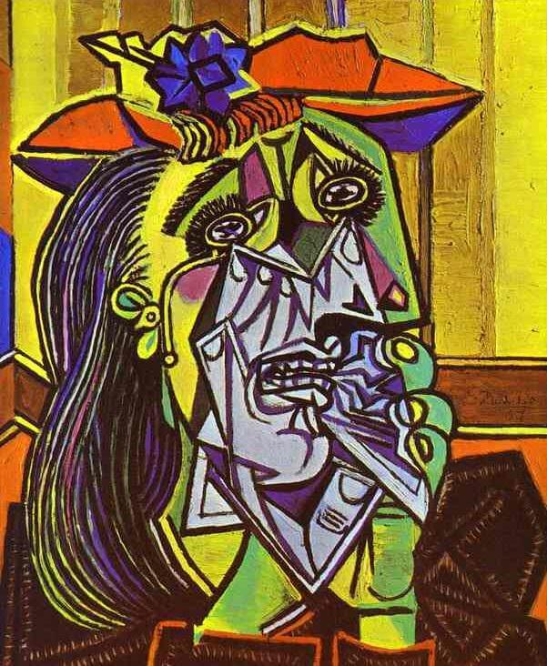
Weeping Woman. Pablo Picasso. 1937. Canvas, 60 x49 cm. London, The Bridgeman Art Library/Art Resource

Slide 5
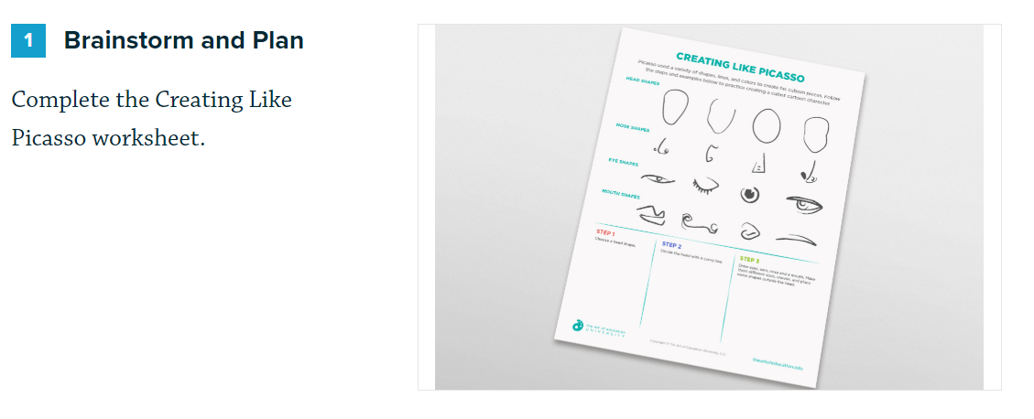

Slide 6
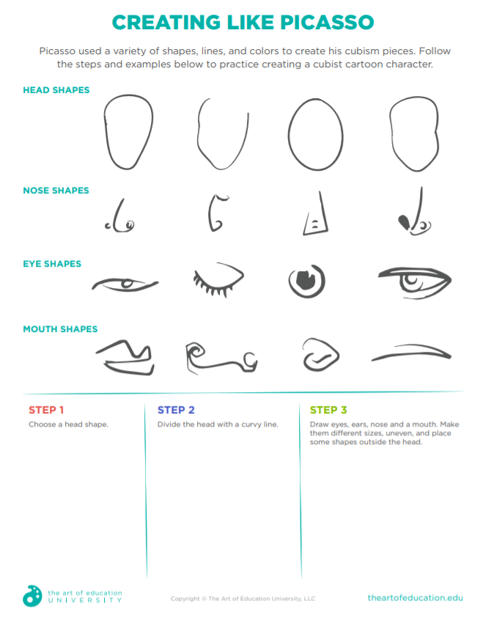

Slide 7
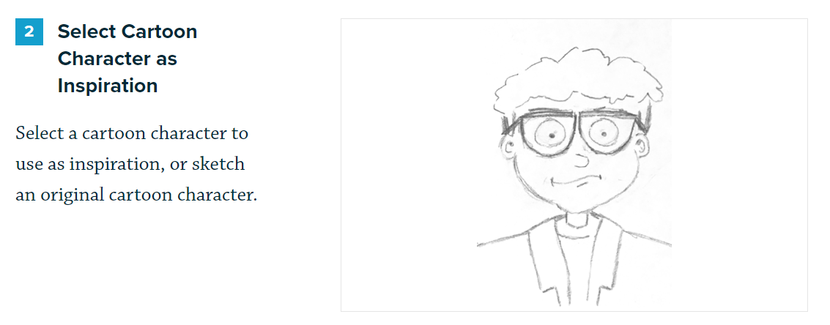

Slide 8
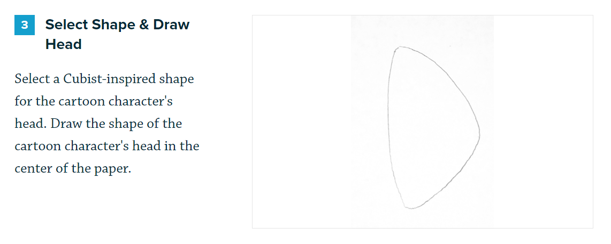

Slide 10
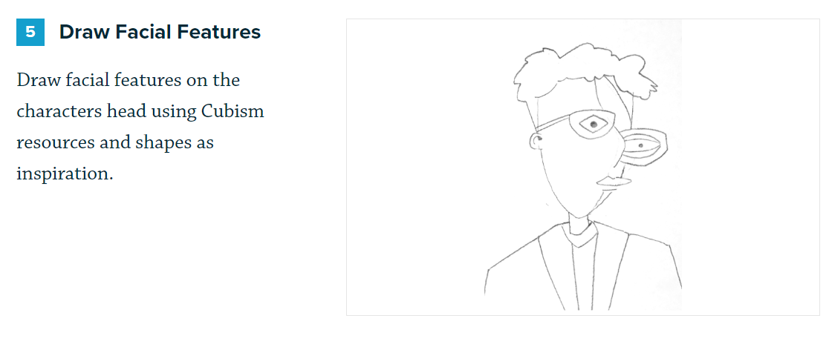

Slide 11
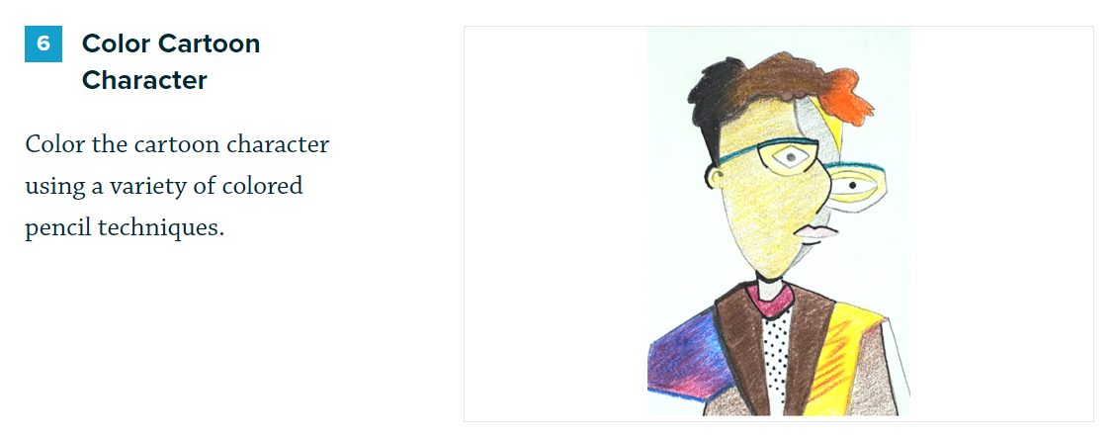

Slide 12
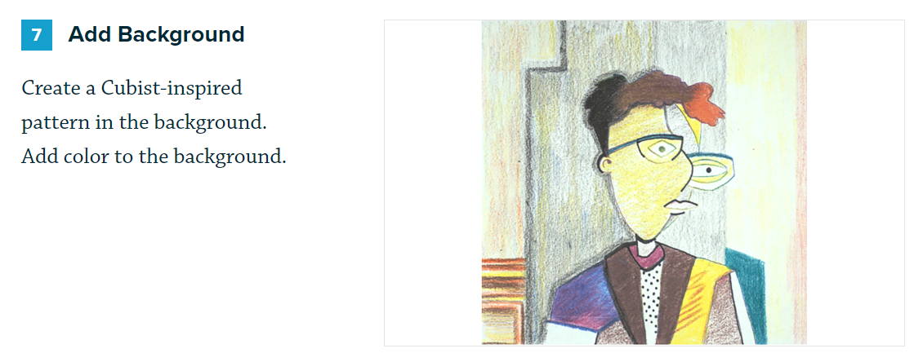

Slide 13
References:
Creative Cubism Cartoon Lesson https://theartofeducation.edu/flex/lesson-plans/creative-cubism-cartoons/
Pablo Picasso Artist Bio
https://dl.airtable.com/.attachments/779f641b11a1037f75355cc3e94fd471/dbf837d4/PabloPicassoArtistBio.pdf
Three Musicians https://www.pablopicasso.org/three-musicians.jsp
The Weeping Woman. https://www.pablopicasso.org/the-weeping-woman.jsp

